Slide 1

General Education Reforms
Lali Kalandadze
Preschool and General Education
Department
Transforming Georgia's educational landscape through strategic reform and comprehensive policy implementation. This presentation outlines our unified approach to building a world-class education system that serves every Georgian student.

Slide 2
2022-2030 Unified National Strategy of Education, Science and Youth of Georgia
Georgia's comprehensive education strategy establishes three foundational pillars that will guide our transformation over the next decade. These interconnected principles ensure our education system meets international standards while addressing local needs and challenges.
Quality and relevance
Equality, inclusion, and diversity
Governance, financing, and accountability
The development of a quality and sustainable education and science system focused on the needs of the students, society, and the state. We prioritize evidence-based curriculum design, modern pedagogical approaches, and continuous assessment mechanisms to ensure educational excellence.
Development of an equal, inclusive, and diverse education and science system: Regardless of their socio-economic status, place of residence, ethnicity/language, special educational needs, and disabilities, every person has access to high-quality educational services throughout the country.
Mobilization of state financial resources, effective and optimal use of limited resources, support for decentralization, and autonomy of management of educational or scientific institutions with effective mechanisms of balanced accountability and control.

Slide 3






Quality and relevance
Quality and relevance pillar encompasses comprehensive reforms across curriculum, assessment, and professional development. These initiatives work synergistically to create a robust educational foundation that prepares students for 21st-century challenges while maintaining Georgian cultural identity.
National Curriculum
National Assessment
Modernized curriculum standards aligned with international best practices, emphasizing critical thinking, creativity, and practical skills application across all subject areas.
Comprehensive evaluation framework ensuring consistent quality measurement and student progress tracking throughout the education system.
Specialized Upper Secondary
New Textbooks
Enhanced pathways for specialized learning, preparing students for higher education and career readiness through targeted academic and vocational programs.
Updated educational materials incorporating modern pedagogical approaches, digital integration, and culturally relevant content for enhanced learning experiences.
Teacher Professional Development
Learning Management System
Continuous training programs ensuring educators possess cutting-edge skills and methodologies to deliver high-quality instruction and support student achievement.
Digital platform facilitating seamless educational delivery, resource sharing, and progress monitoring for enhanced teaching and learning effectiveness.
National Goals of General Education serve as the guiding framework for all these quality initiatives, ensuring coherent implementation across the system.

Slide 4












Equality, inclusion, and diversity
Creating an inclusive educational environment where every Georgian student thrives regardless of background, ability, or circumstance. Our comprehensive approach addresses systemic barriers while building strong community partnerships to support student success.
Parents as Partners
Special Needs Support
Active engagement strategies bringing families into the educational process as collaborative partners in student learning and school community development.
Specialized services and accommodations ensuring students with disabilities and special educational needs receive appropriate support and inclusive learning opportunities.
Student Wellbeing
School Infrastructure
Comprehensive support services addressing mental health, social-emotional learning, and overall student wellness to create optimal learning conditions.
Modern, accessible facilities equipped with necessary resources to support diverse learning needs and create safe, welcoming environments for all students.
Non-Formal Education
Public Awareness
Alternative learning pathways and extracurricular opportunities expanding educational access and addressing diverse learning styles and interests.
Community outreach and transparency initiatives promoting understanding of inclusive education principles and building broader social support.
The Student – Parent – School partnership triangle forms the foundation of our inclusive approach, ensuring collaborative responsibility for every child's educational success.

Slide 5

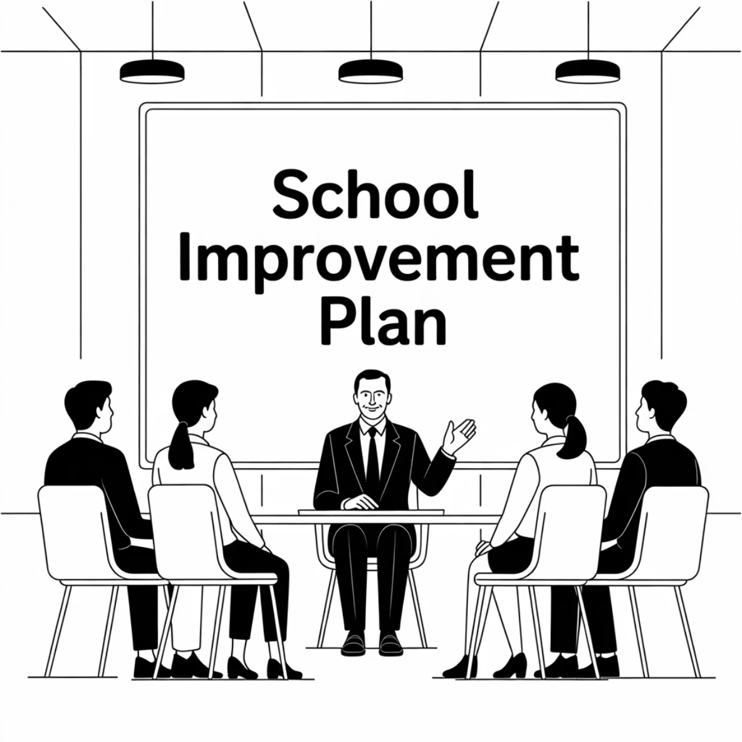



Governance, financing, and accountability
Establishing robust governance structures that balance autonomy with accountability while optimizing resource utilization. Our comprehensive approach strengthens institutional capacity and ensures effective oversight at all levels of the education system.
Legal Entity of Public Law (L.E.P.L)
Enhanced institutional autonomy through specialized legal frameworks enabling more flexible and responsive educational governance structures.
Digital Infrastructure
Integrated systems including eSchool, Geographic Information Systems, and electronic journals streamlining administrative processes and improving data management.
Resource Centers
Regional hubs providing specialized support, professional development, and resource sharing to enhance educational capacity across all districts.
Authorization Framework
Quality assurance mechanisms ensuring educational institutions meet established standards while maintaining accountability and continuous improvement.
School Autonomy empowers local educational leaders to make decisions that best serve their communities while maintaining system-wide quality standards.

Slide 6

Thank you
Questions & Discussion

